Slide 1
CONDITION EXECUTION

Slide 2
Agenda
How to use “if condition” in conditional Structures
How to use “elif” condition
Nested IF Statements
Debugging

Slide 3
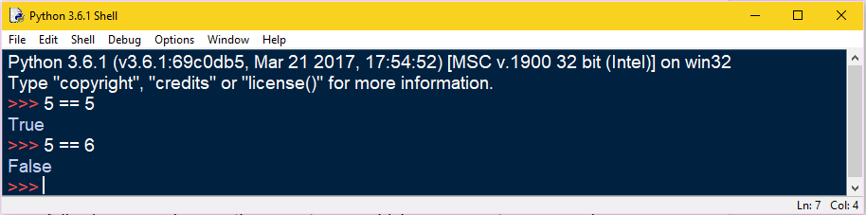
Condition Execution
Boolean Expression:A Boolean expression is an expression that is either true or false. The following examples use the operator ==, which compares two operands and produces True if they are equal and False otherwise:

Slide 4
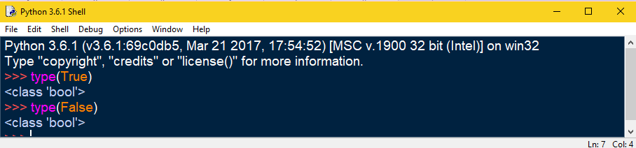
Continue…
True and False are special values that belong to the type bool; they are not Strings

Slide 5
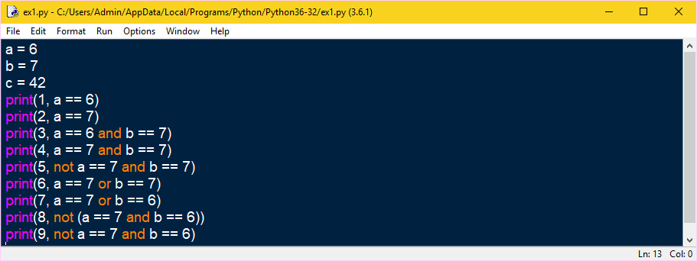
Continue…
Some Boolean expressions are given below
Example 1:

Slide 6
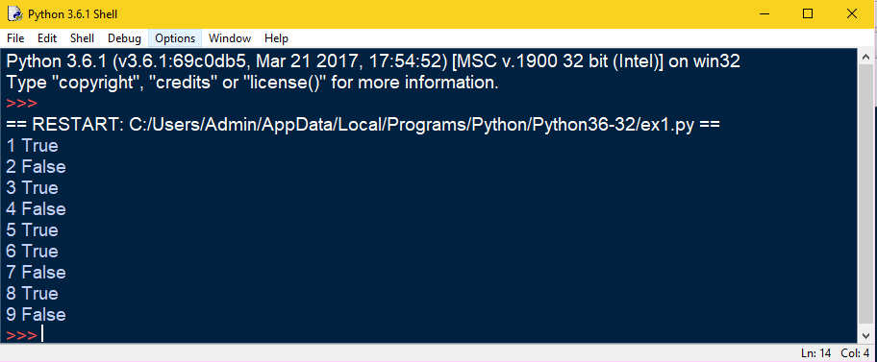
Continue…

Slide 7
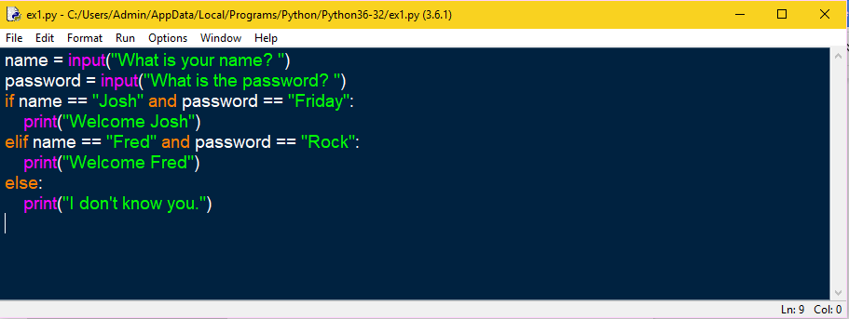
Continue….
Example 2: This program asks a user for a name and a password it then check them to make sure that the user is allowed in.
Program name: Sample.py

Slide 8
Logical operators
There are three logical operators: and, or, and not. The semantics (meaning) of these operators is similar to their meaning in English.
For example x>0 and x<10, is true only if x is greater than 0 and less than 10.
n%2==0 or n%3==0, is true if either of the conditions is true, that is, if the number is divisible by 2 or 3.
Finally, the not operator negates a Boolean expression, so not (x > y) is true if x > y is false, that is, if x is less than or equal to y.

Slide 9
Conditional execution
In order to write useful programs, we almost always need the ability to check conditions and change the behavior of the program accordingly. Conditional statements give us this ability.
The simplest form is the if statement
An if statement consists of a boolean expression followed by one or more statements.

Slide 10

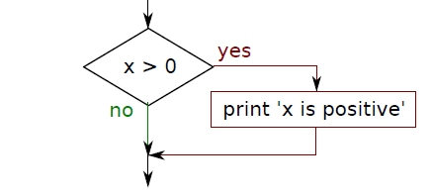
If Statement
An if statement consists of a boolean expression followed by one or more statements.
The Boolean expression after the if statement is called the condition. We end the if statement with a colon character (:) and the line(s) after the if statement are indented.

Slide 11
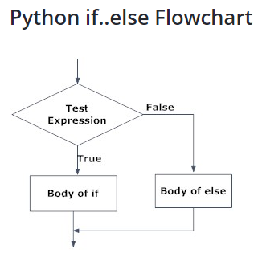
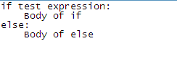
If else Statement
The if..else statement evaluates test expression and will execute body of if only when test condition is True.
If the condition is False, body of else is executed. Indentation is used to separate the blocks.

Slide 12
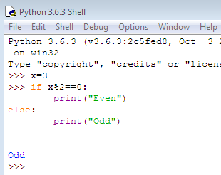
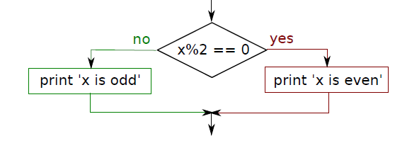
Continue…

Slide 13
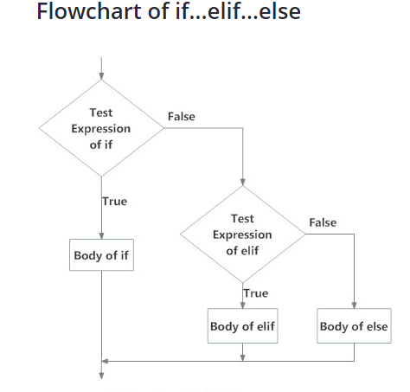
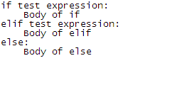
If..elif..else
The elif is short for else if. It allows us to check for multiple expressions.
If the condition for if is False, it checks the condition of the next elif block and so on. If all the conditions are False, body of else is executed.

Slide 14
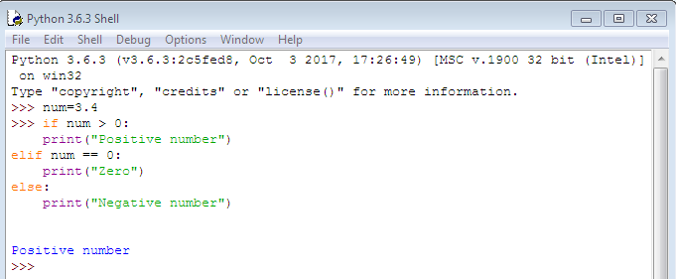
Example

Slide 15
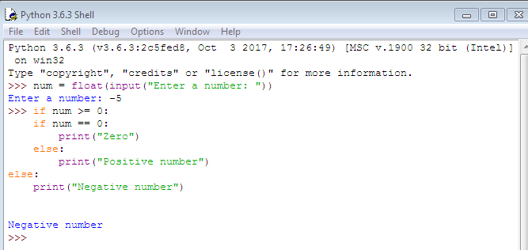
Nested If Statement
We can have a if...elif...else statement inside another if...elif...else statement. This is called nesting in computer programming.

Slide 16
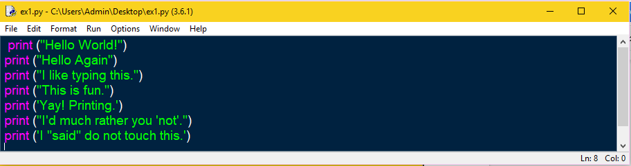
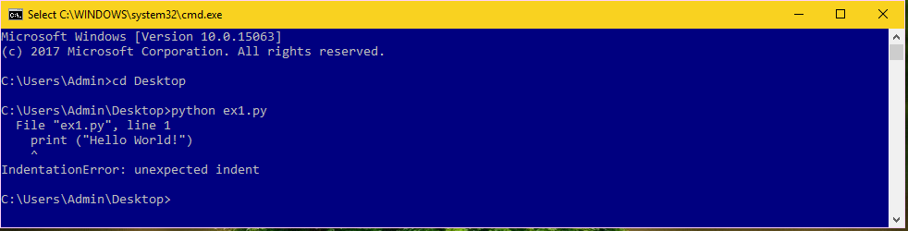
Debugging
Debugging is the process of finding and resolving defects or problems within the program that prevent correct operation of computer software or a system

